Slide 1

MuseLink: A Multi-Method Hybrid Recommendation System Enhancing Personalized Recommendations Through Machine Learning Techniques
Presented by: Dattatreya Kantha
GWID:G35579113

Slide 2

Motivation and Objective
Challenges in Traditional Recommendation Systems:
Struggle with data sparsity and cold-start issues.
Fail to integrate diverse data sources like user interactions and metadata effectively.
Limited scalability and personalization, especially for niche users.
Objective:
MuseLink addresses these challenges by integrating collaborative, content-based, and graph-based methods to ensure personalized and diverse recommendations.

Slide 3
Inspiration
MuseLink draws inspiration from the paper Song Recommendation with Non-negative Matrix Factorization and Graph Total Variation. (LINK)
Original Paper’s Approach: Combines Non-negative Matrix Factorization (NMF) with graph-based total variation for song recommendations.
Reported Performance: Achieves playlist category accuracy of up to 0.846 and MPR (Mean Percentage Ranking) as low as 0.074 on sampled data.
MuseLink’s Objective: Build on this foundation by integrating newer, advanced techniques for improved personalization and accuracy.
Comparison Goal: Benchmark MuseLink’s performance against the original model using similar metrics.

Slide 4

Project Overview
Objective: Develop a robust hybrid recommendation system that personalizes music suggestions by integrating diverse user interactions, metadata, and graph-based relationships.
Approach: Combines collaborative filtering, content-based filtering, and graph-based techniques to enhance recommendation accuracy and diversity.
Technologies Used:
Python: Core programming language.
PyTorch & TensorFlow: For deep learning-based models like NCF.
PyTorch-Geometric: For Graph Neural Networks (GCNs).
Node2Vec: Generating graph embeddings.
Scikit-Learn: Feature engineering and evaluation.
Flask: Framework for user interaction.
Key Highlights: Seamlessly integrates collaborative, content-based, and graph-based methods into a hybrid system, achieving superior personalization, scalability, and performance across key evaluation metrics(Precision@10, Recall@10, NDCG@10, and MPR).

Slide 5
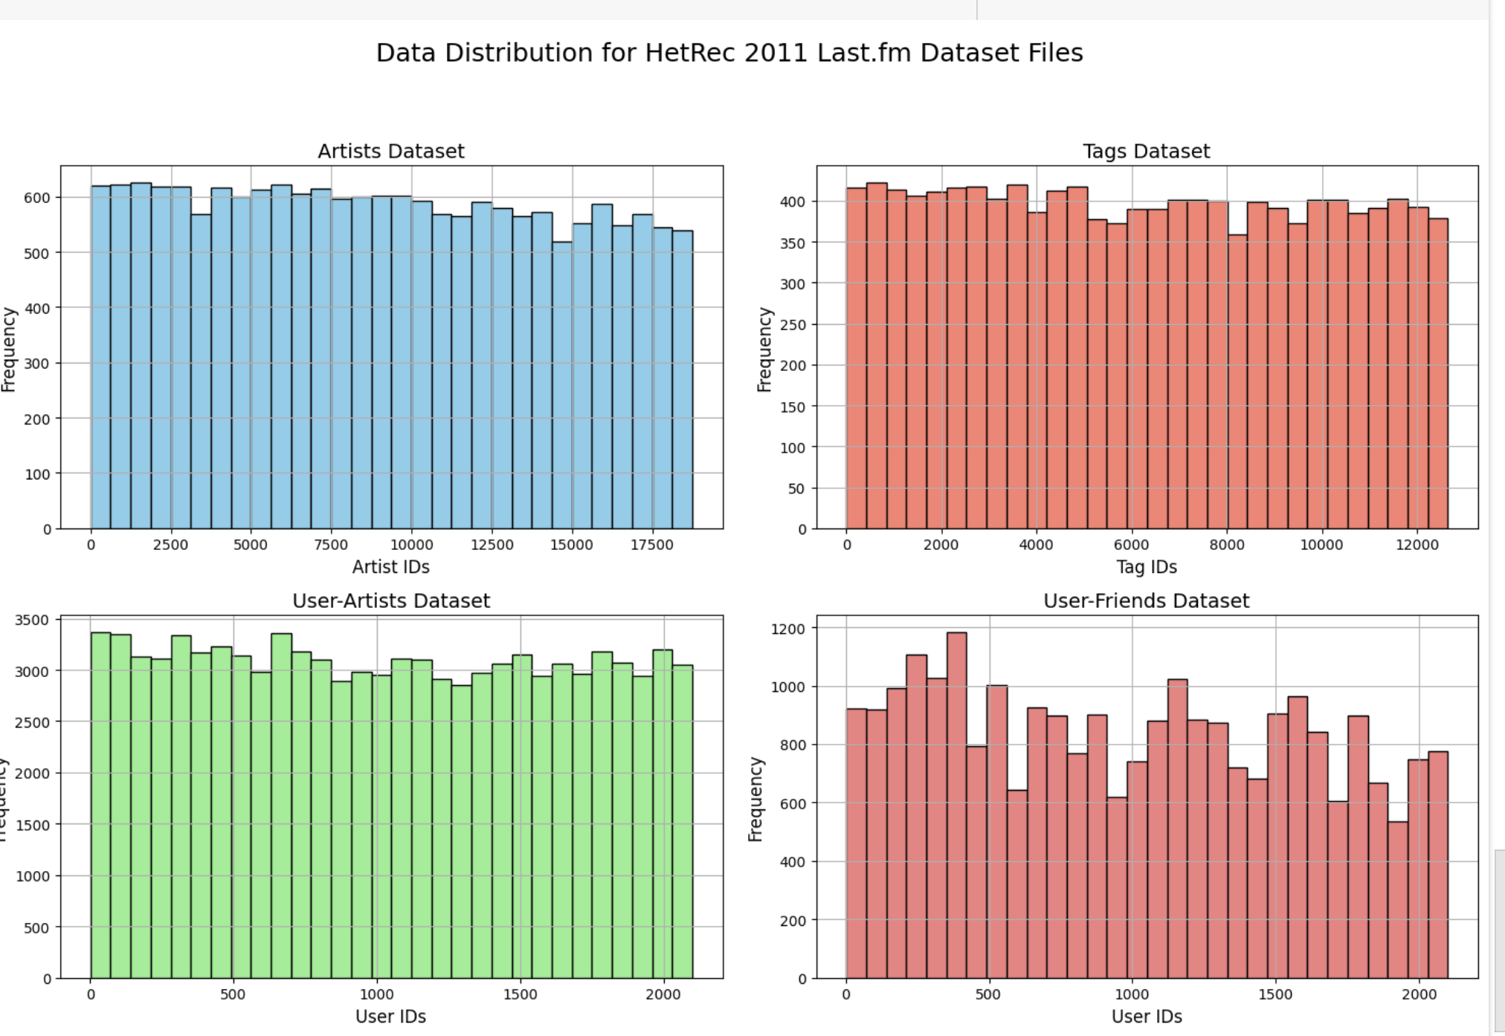
Data Distribution for HetRec 2011 Last.fm Dataset Files (Part 1)
Source: HetRec 2011 Last.fm Dataset, a rich dataset capturing user listening patterns, social connections, and metadata.
Artists Dataset:
Contains 17,600 unique artist IDs, with each ID appearing approximately 500–600 times.
A balanced representation ensures robust user-artist modeling.
Tags Dataset:
Includes 12,500 unique tags distributed across genres and moods, with each tag assigned approximately 350–450 times.
Key for creating diverse, content-rich recommendations.
User-Artists Dataset:
Contains 1,892 users interacting with artists, with an average of 2,500–3,500 interactions per user.
High engagement levels support personalized modeling.
User-Friends Dataset:
12,717 bi-directional friendships, showing diverse social interactions.
Crucial for social graph modeling in GCNs and Node2Vec.
Visualizations:Graphs showcasing distribution patterns for artist IDs, tag counts, user-artist interactions, and social connections.

Slide 6
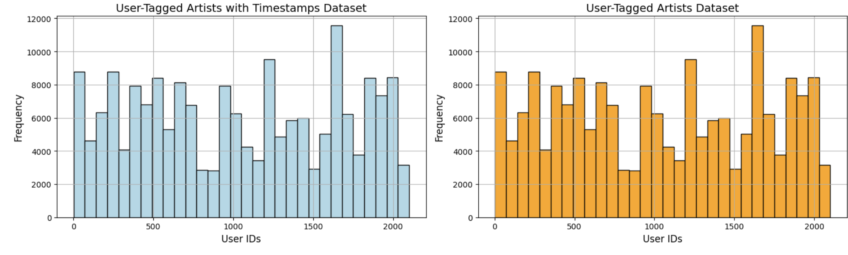
Data Distribution for HetRec 2011 Last.fm Dataset Files (Part 2)
User-Tagged Artists with Timestamps Dataset:
Captures 1,892 users tagging activity over time, with tagging frequencies ranging from 2,000 to over 10,000 per user.
Highlights variability in user behavior and tagging preferences.
User-Tagged Artists Dataset:
Frequency ranges between 2,000–10,000 tags per user, reflecting diverse tagging interests and personalized interactions.
Key for enhancing content-based filtering and metadata utilization.
Visualizations:
Histograms illustrating the tagging behavior over time and user-tag distributions.

Slide 7
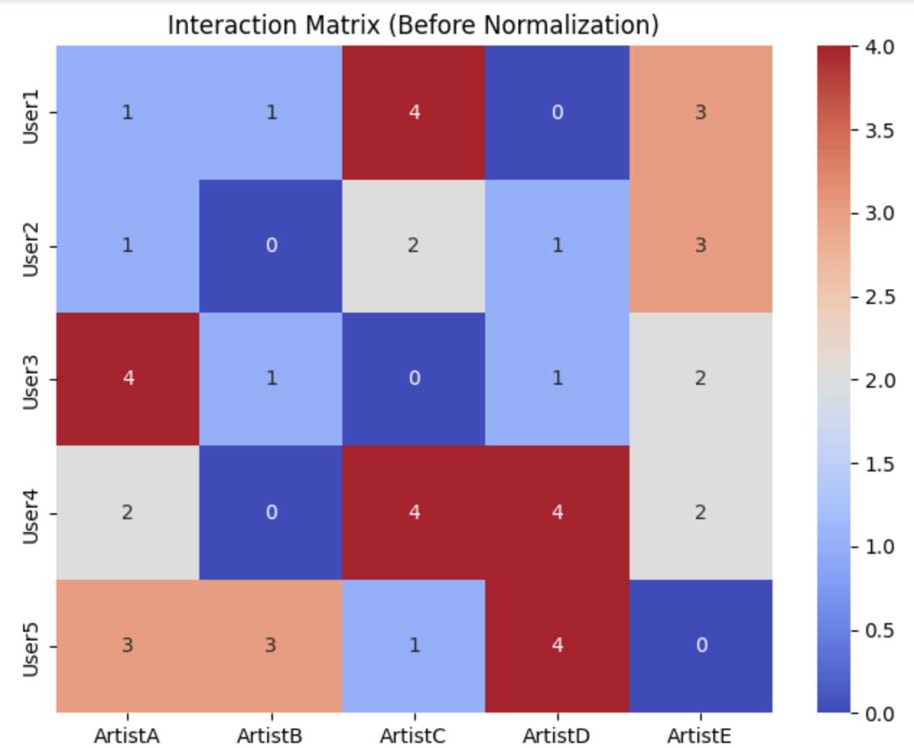
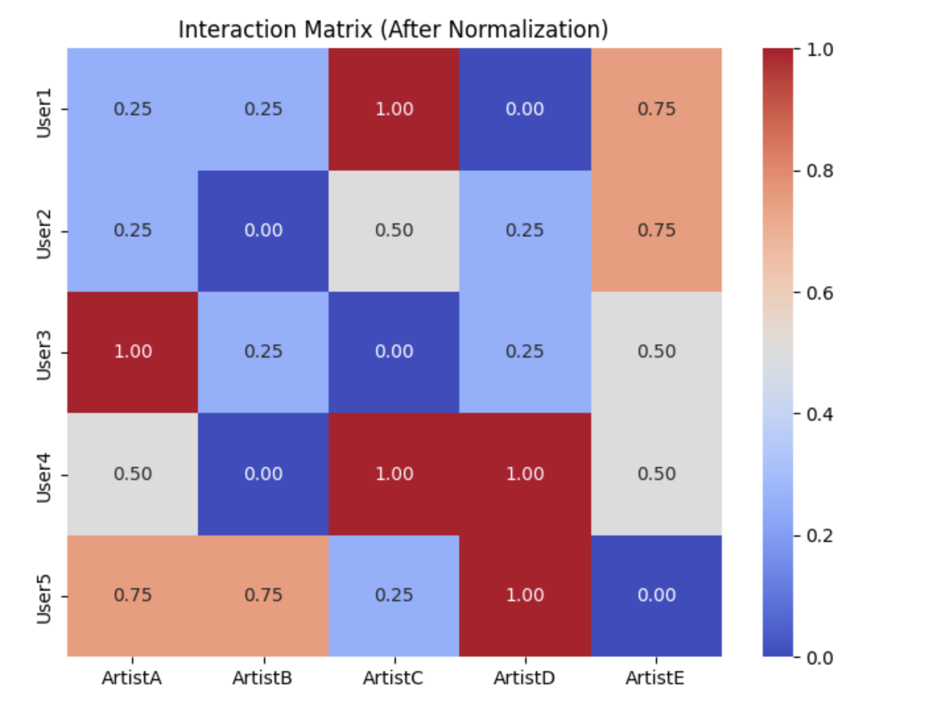
Data Cleaning and Preprocessing
Steps Taken:
Removed duplicates in artists.dat, tags.dat, user_artists.dat, etc.
Handled Missing Values:
Filled 444 missing entries in pictureURL with 'NoURL.'
Verified other datasets for completeness.
Normalized Interaction Weights: Min-Max scaling of listening counts to address data skewness.
Merge Operations:
Integrated user-artist interaction data with artist metadata and tag names for enriched features.

Slide 8
Feature Engineering
User Features:
Created interaction matrices and tag profiles using user-tag mappings.
Artist Features:
Graph Features:
Built interaction and tag-based similarity graphs.
Generated Node2Vec embeddings for capturing local and global relationships.
Enhancements:
Applied log-transformation to weights and validated features using clustering and visualization.
Processed tags with TF-IDF embeddings (5000 dimensions).Normalized interaction weights to improve scalability.

Slide 9
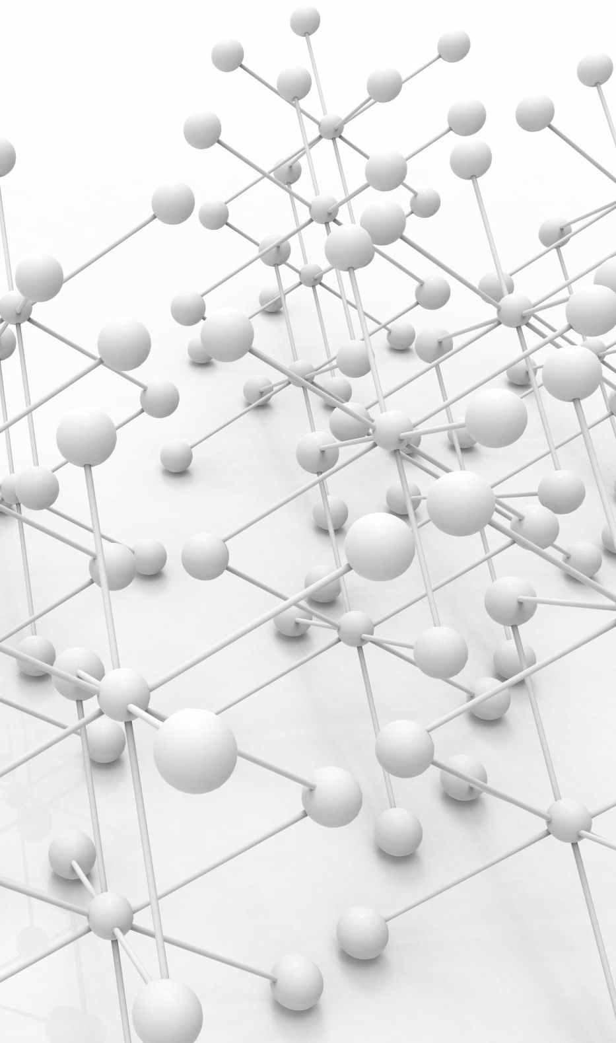
Model Overview
Implemented Models:
Neural Collaborative Filtering (NCF):
Learns latent user-artist interaction patterns using deep learning.
Content-Based Filtering:
Recommends artists based on metadata and tag similarities.
Graph Convolutional Networks (GCNs):
Models user-artist relationships through graph feature propagation.
Node2Vec:
Generates embeddings for graph-based insights.
Hybrid Model:
Integrates all methodologies for comprehensive recommendations.
Why These Models?
NCF for capturing complex user-item interactions.
Content-based filtering for leveraging metadata.
GCN for graph structure exploitation.
Node2Vec for embedding generation.
Hybrid for combining the strengths of all.

Slide 10

Model Implementation
NCF:
Embedded user and artist IDs into dense vectors.
Used dense layers and binary cross-entropy loss for training.
Content-Based Filtering:
Applied cosine similarity to TF-IDF tag embeddings.
Ranked artist similarities for user recommendations.
GCN:
Integrated normalized weights and Node2Vec embeddings into graph layers.
Node2Vec:
Generated embeddings with walk length 20, dimensions 128, and 10 walks per node.
Hybrid:
Dynamically weighted outputs of all models for robust final recommendations.
Implementation Highlights:
Early stopping for NCF to prevent overfitting.
Regularization in Node2Vec to address slight overfitting.
Fusion tuning for Hybrid.

Slide 11

Evaluation Metrics
Chosen Metrics for Evaluating Recommendations:
Precision@10: Focuses on the proportion of relevant recommendations.
Recall@10: Measures coverage of relevant items retrieved.
NDCG@10: Assesses ranking quality, accounting for the position of items.
Mean Percentage Ranking (MPR): Evaluates the ranking position of relevant items.
Additional Metrics:
Training, validation, and testing accuracies to track overall performance.
Why These Metrics?
Provides a holistic view of the system’s ability to retrieve, rank, and cover relevant recommendations.

Slide 12
Performance Comparison
Model | Training(%) | Validation (%) | Testing(%) | Precision@10 | Recall@10 | NDCG@10 | MPR | Observations
Baseline | - | - | - | 0.1 | 0.02 | 0.14 | 0.2 | Generic recommendations with low relevance; lacks personalization.
NCF | 93.69 | 90.65 | 90.65 | 0.38 | 0.9 | 0.92 | 0.34 | High relevance and precision; struggles with diversity in niche recommendations.
GCN | 97.09 | 97.0 | 96.54 | 0.7 | 0.14 | 0.81 | 0.57 | Captures graph relationships well; recall is limited for niche recommendations.
Node2Vec | 99.0 | 95.79 | 95.88 | 0.93 | 0.99 | 0.95 | 25.27 | Strong ranking quality but slightly overfits; .
Content-Based | 90.03 | 86.8 | 86.95 | 0.27 | 0.37 | 0.54 | 0.05 | Effective for metadata-rich users; struggles with sparsity in data.
Hybrid | 98.89 | 98.88 | 98.87 | 0.75 | 0.9 | 0.97 | 0.35 | Combines strengths of all models; delivers the best overall performance.
Model Metrics:
Detailed table with metrics like Precision@10, Recall@10, NDCG@10, and MPR.
Key Insights:
Baseline demonstrates limited relevance with low Precision@10 and Recall@10.
Hybrid model excels across all metrics, showcasing its ability to leverage diverse methodologies.
NCF shows strong relevance but struggles with diversity.
GCN captures graph relationships but has lower recall for niche recommendations.
Node2Vec ranks well but requires hybrid integration for balanced performance + slightly overfits

Slide 13
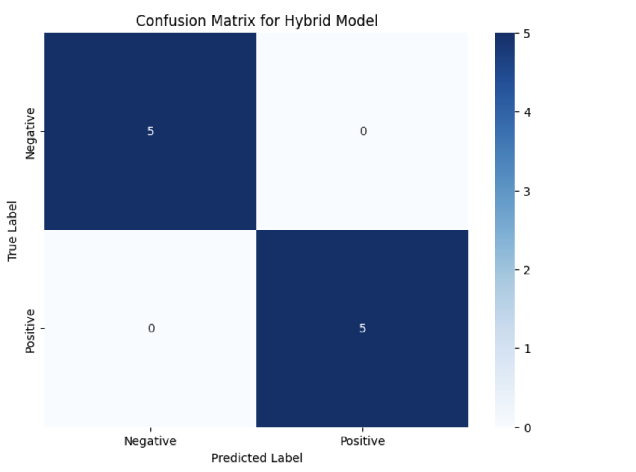
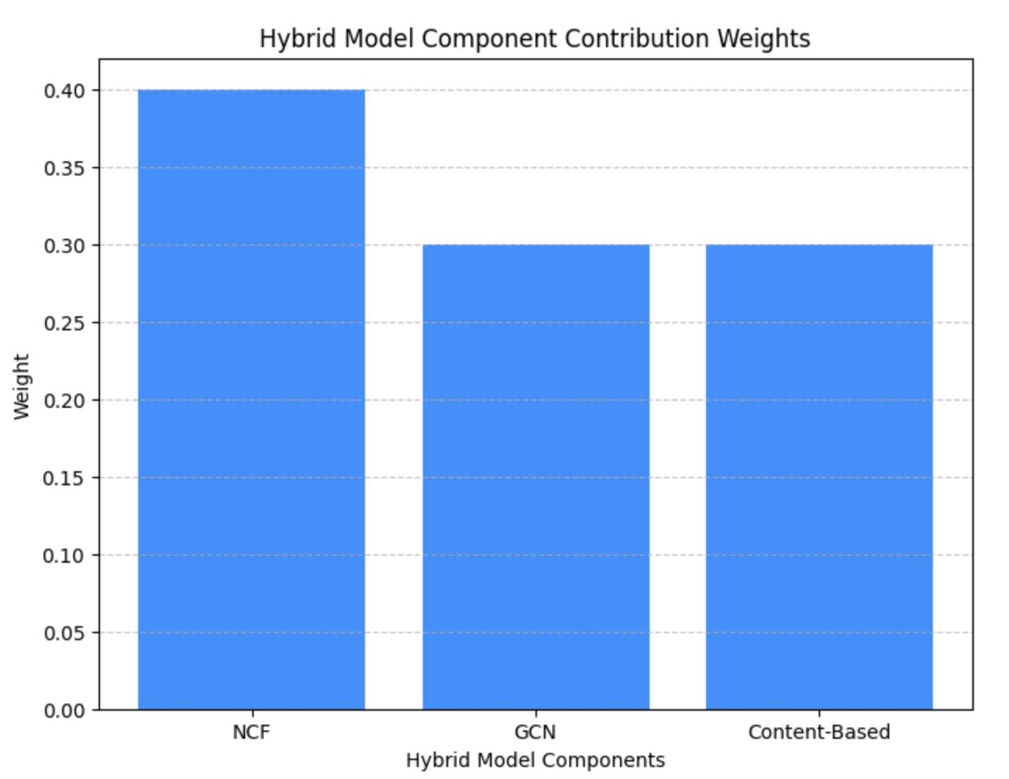
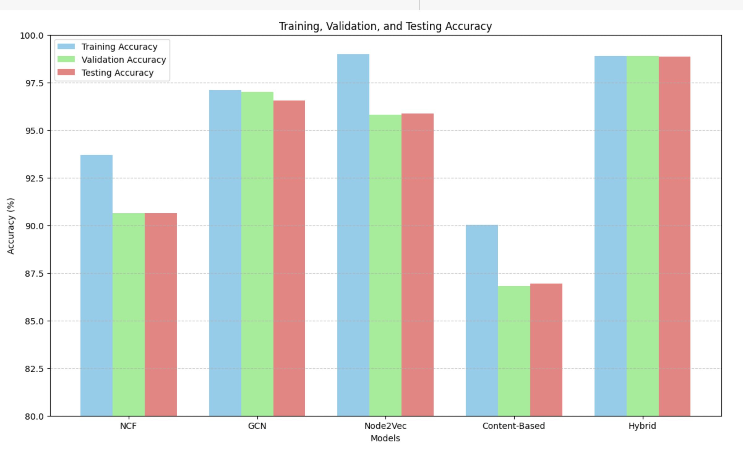
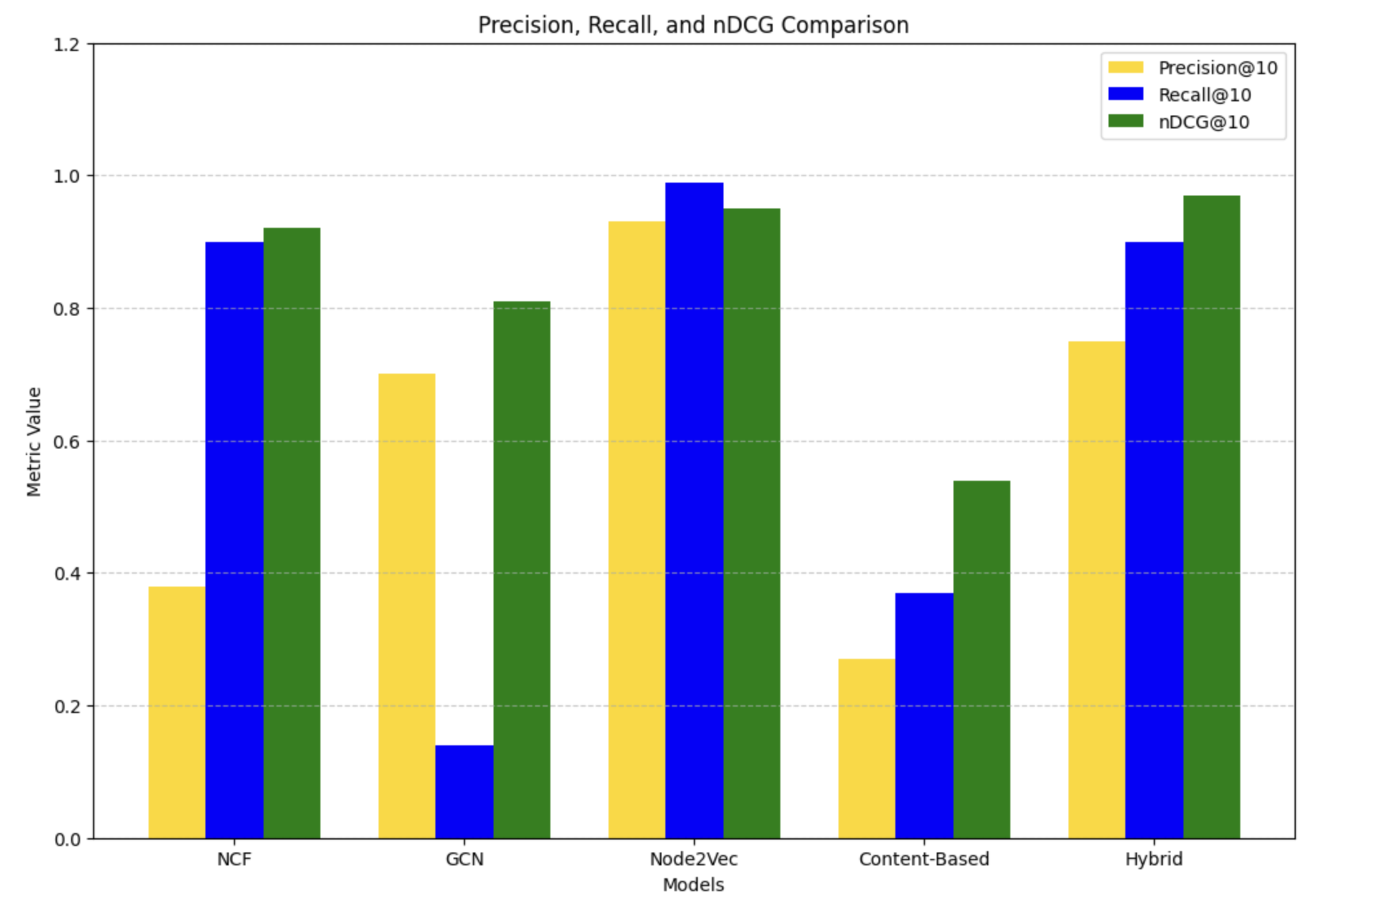
Analysis of Recommendations
Baseline Model: Provides generic popularity-based recommendations, leading to low Precision@10 and Recall@10, emphasizing the need for personalization.
NCF: Achieves high NDCG@10 with effective ranking but lacks diversity, favoring popular items.
Content-Based Filtering: Performs well with detailed metadata but struggles with sparse data, lowering Recall@10.
GCNs: Captures graph relationships with strong NDCG@10 but limited Recall@10 for niche users.
Node2Vec: Balances relevance and coverage with high NDCG@10 and Recall@10 but shows slight overfitting.
Hybrid Model: Combines all strengths, delivering the highest scores in Precision@10, Recall@10, and NDCG@10, with a balanced confusion matrix indicating robust performance. The hybrid model excels by combining diverse methods, ensuring high precision, diversity, and scalability, making it ideal for real-world use.

Slide 14
Comparison with Reference Paper
Aspect | Original Paper's Approach | MuseLink's Approach
Graph-Based Structure | Uses graph regularization for song-user modeling. | Employs GCNs and Node2Vec for advanced graph embeddings.
Collaborative Filtering | NMF for collaborative filtering. | NCF for deep, neural-based user-item predictions.
Content-Based Filtering | Relies on metadata (genres/tags) for recommendations. | TF-IDF for enriched content-based filtering.
Hybrid System | Combines NMF and metadata-based methods. | Fusion strategy integrates collaborative, content-based, and graph-based models.
Performance | Accuracy: 0.846; MPR: 0.074. | Hybrid Testing Accuracy: 0.9887; NDCG@10: 0.97; MPR (Hybrid): 0.35. Content-Based MPR: 0.046, outperforming paper.
Innovation | Focused on playlist accuracy for sampled data. | Focused on personalized artist and tag recommendations with enhanced diversity and scalability.
Why MuseLink Excels:
Superior Testing Accuracy: Achieved 0.9887 with the hybrid model, surpassing the original approach.
NDCG@10: Scored 0.97, indicating top-notch ranking quality.
Enhanced MPR: Content-based MPR (0.046) outperforms the paper’s MPR (0.074).
Advanced Techniques: Incorporates GCN and Node2Vec embeddings for deeper graph insights.
Improved Personalization: Combines diverse methods for artist and tag-specific, highly relevant recommendations.
Scalability: Tailored for large-scale real-world applications beyond sampled datasets.

Slide 15

Challenges and Future Directions
Challenges:
Addressing data sparsity and redundancy.
Balancing model complexity with performance.
Ensuring recommendations cater to niche user preferences.
Future Directions:
Explore transformer-based embeddings for richer feature extraction.
Introduce attention mechanisms in GCN for better graph representation.
Implement dynamic weight adjustments in the hybrid model using meta-learning.

Slide 16
Web Application Interface
Input Collection
Every model (e.g.,only NCF now) has been converted from Python to JavaScript using the TensorFlow.js library.
These models are loaded into the Node.js framework.
The model returns artist IDs based on the input.
Real-Time
Python models are converted to JavaScript and loaded into the Node server (Node.js).
Every time the user clicks on recommendations, their user ID is sent to the server in real-time.
The server retrieves the recommended artist IDs from the model.
The model only returns artist IDs, and we map them to artist names and tags using the dataset.
Inner joins are used to link artist names and tags for recommendations.
User Experience
The interface is a single-page application.
Based on the availability of recommendation data, results are displayed on the web interface.
The top 10 artists are shown in the UI.
Five random tags are displayed for each artist.
If tag data is unavailable, no tags are displayed.

Slide 17

Conclusion
->
Successfully designed and implemented a personalized recommendation system.
Hybrid model outperformed baseline and individual models.
Leveraged diverse methodologies to achieve high Precision@10, Recall@10, and NDCG@10.
Future enhancements could further improve diversity and scalability.
Acknowledgment:
Inspired by the NMF-TV model from the paper -> ( Song Recommendation with Non-negative Matrix Factorization and Graph Total Variation ) , MuseLink aims to push music recommendation further.

